Slide 1
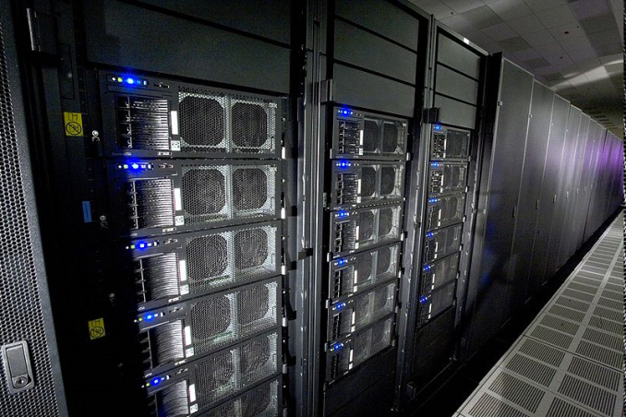
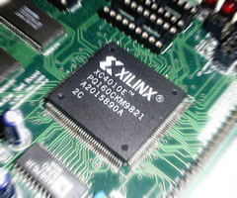
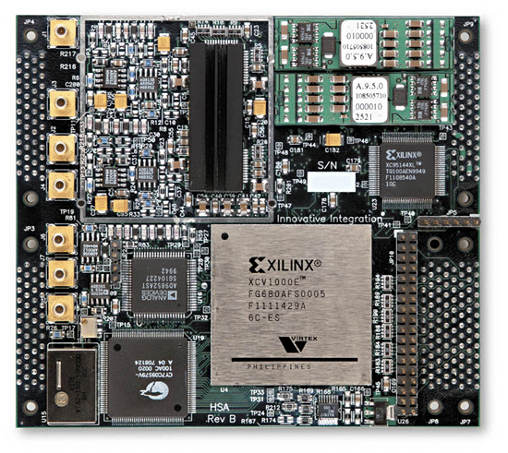
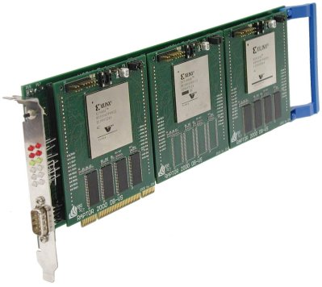
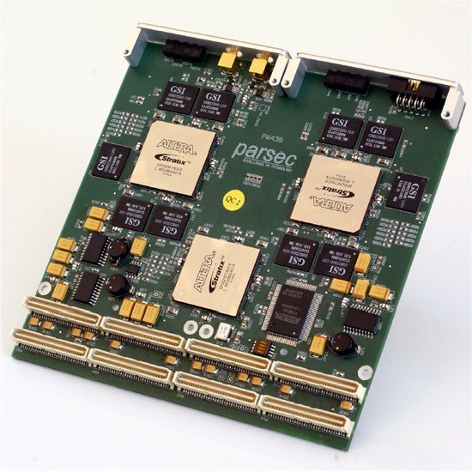
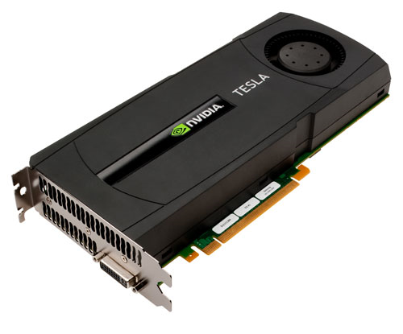

Heterogeneous Computing at USC Dept. of Computer Science and Engineering University of South Carolina
Dr. Jason D. Bakos
Assistant Professor
Heterogeneous and Reconfigurable Computing Lab (HeRC)
This material is based upon work supported by the National Science Foundation under Grant Nos. CCF-0844951 and CCF-0915608.

Slide 2
Our Group: HeRC
Applications work
Computational phylogenetics (FPGA)
High-throughput global sequence alignment for large-scale genomic clustering (GPU)
Sparse linear algebra (FPGA/GPU)
Frequent itemset mining (Multi-core/GPU)
Logic synthesis (GPU)
System architecture
Multi-FPGA interconnects
Tools
Automatic CPU/coprocessor partitioning (PATHS)
Micro-architectural simulation for code tuning

Slide 3
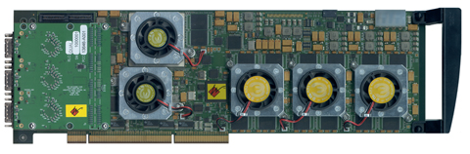
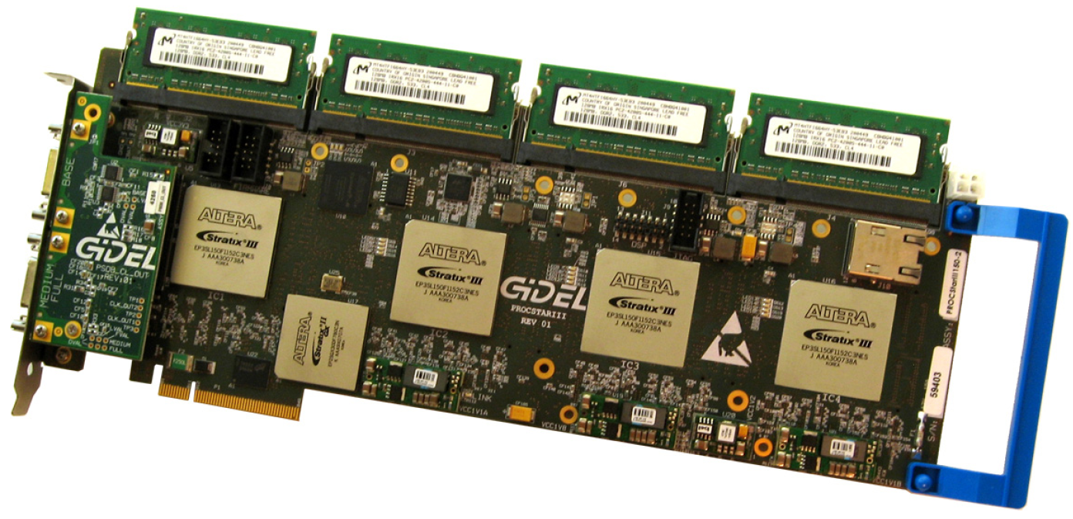
FPGA Platforms
Annapolis Micro Systems
WILDSTAR 2 PRO
GiDEL PROCSTAR III

Slide 4
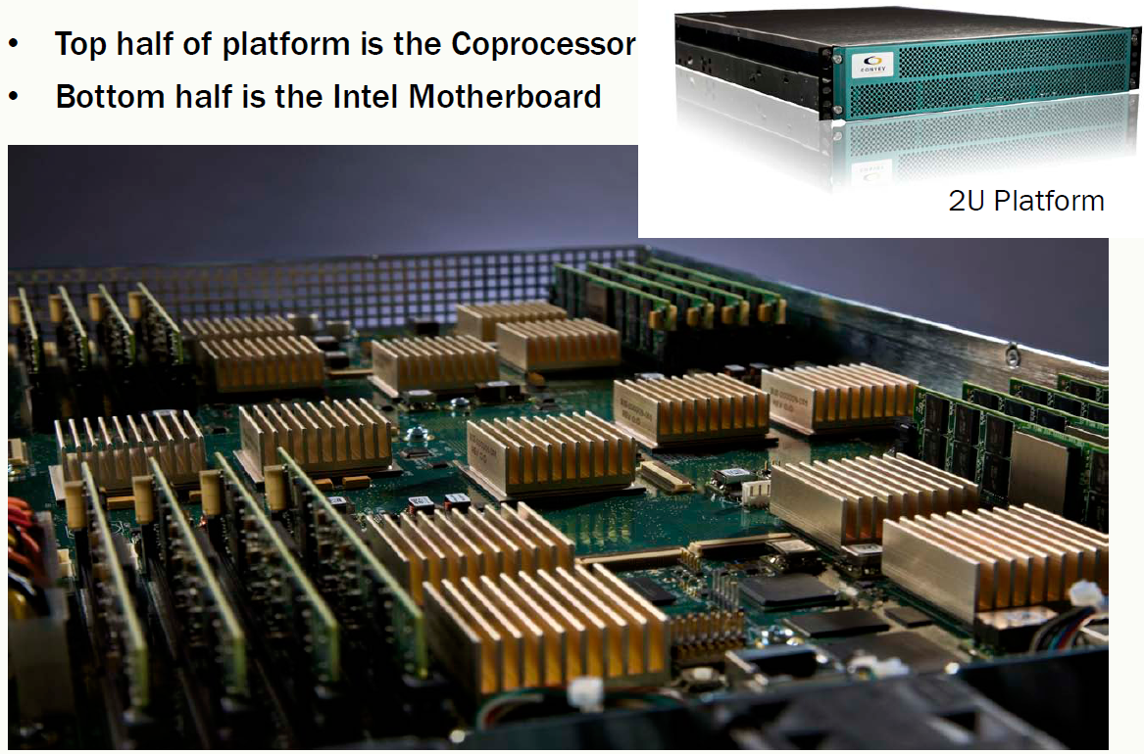
FPGA Platforms
Convey HC-1
Jason D. Bakos, “High-Performance Heterogeneous Computing with the Convey HC-1,” IEEE Computing in Science and Engineering, Nov/Dec’10.

Slide 5
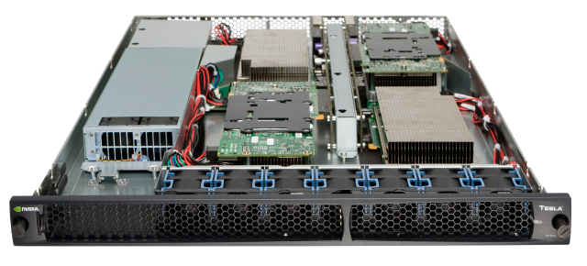
GPU Platforms
NVIDIA Tesla S1070

Slide 6
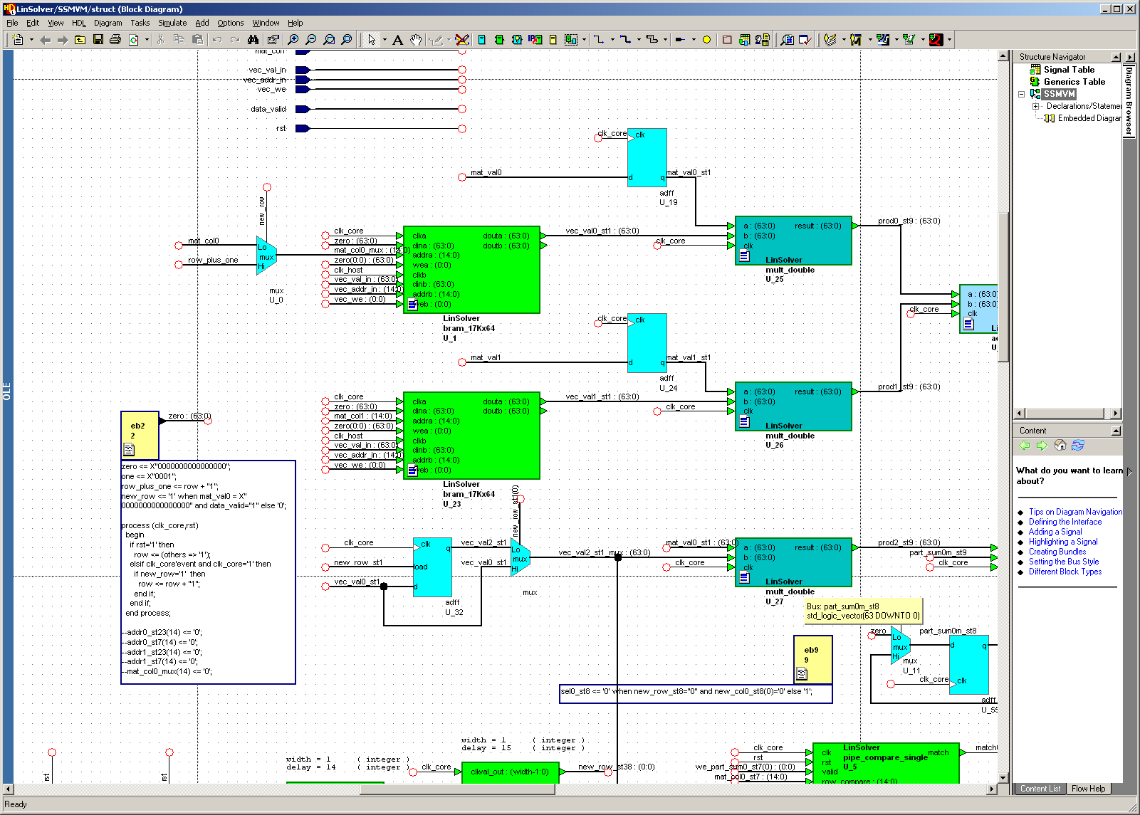
Programming FPGAs

Slide 7
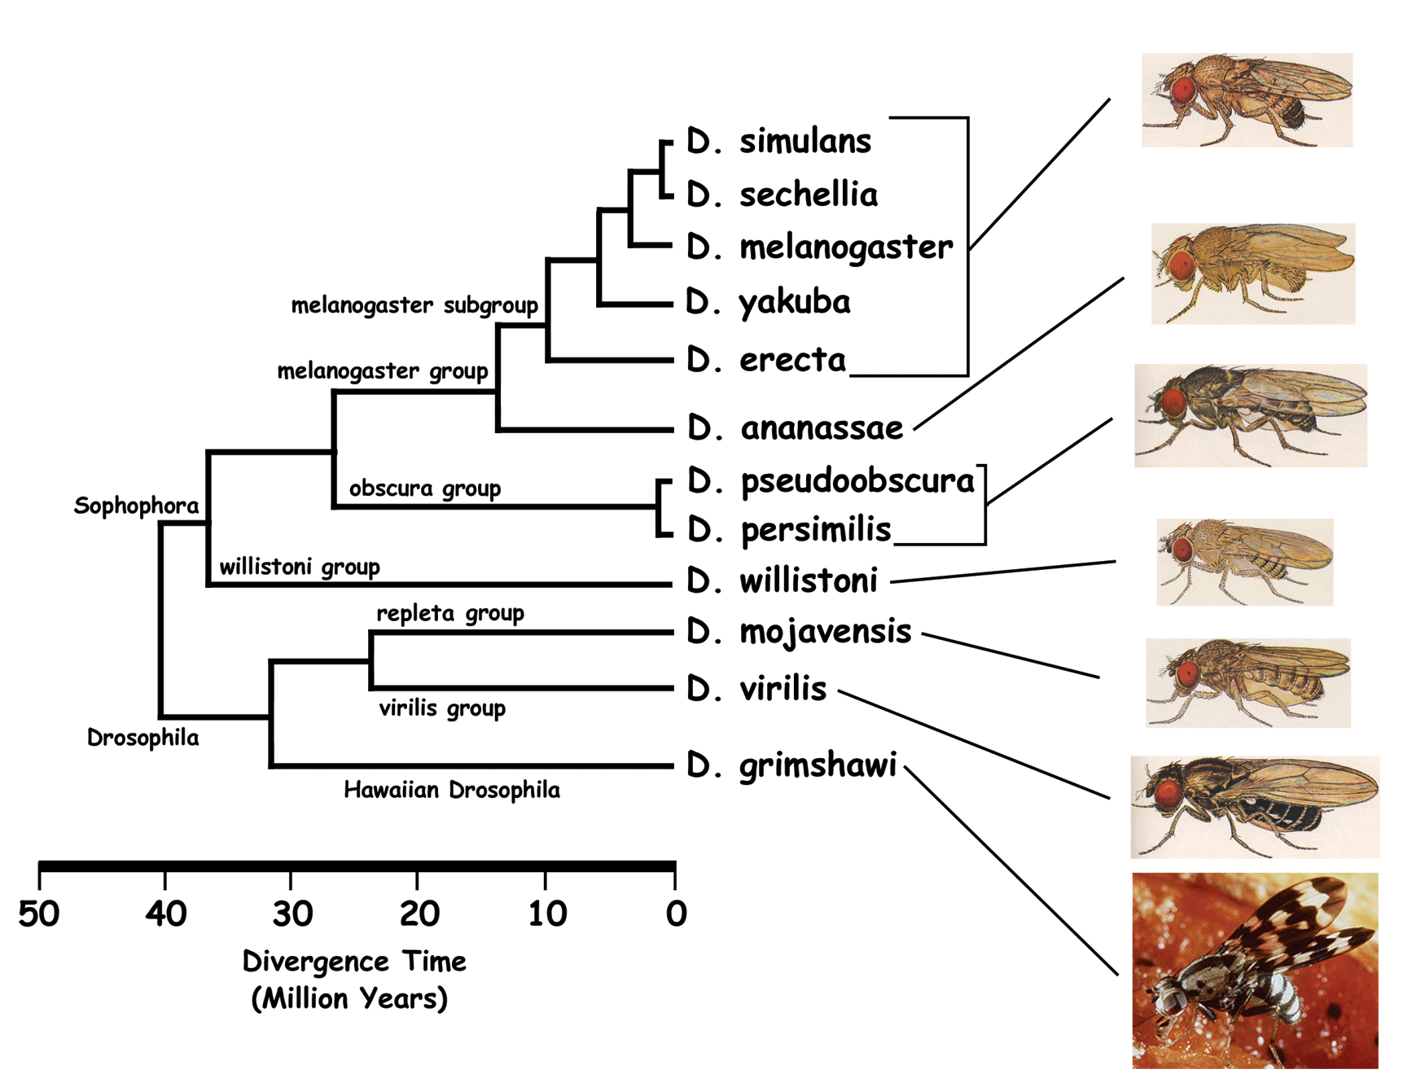
Phylogenies
genus Drosophila

Slide 8
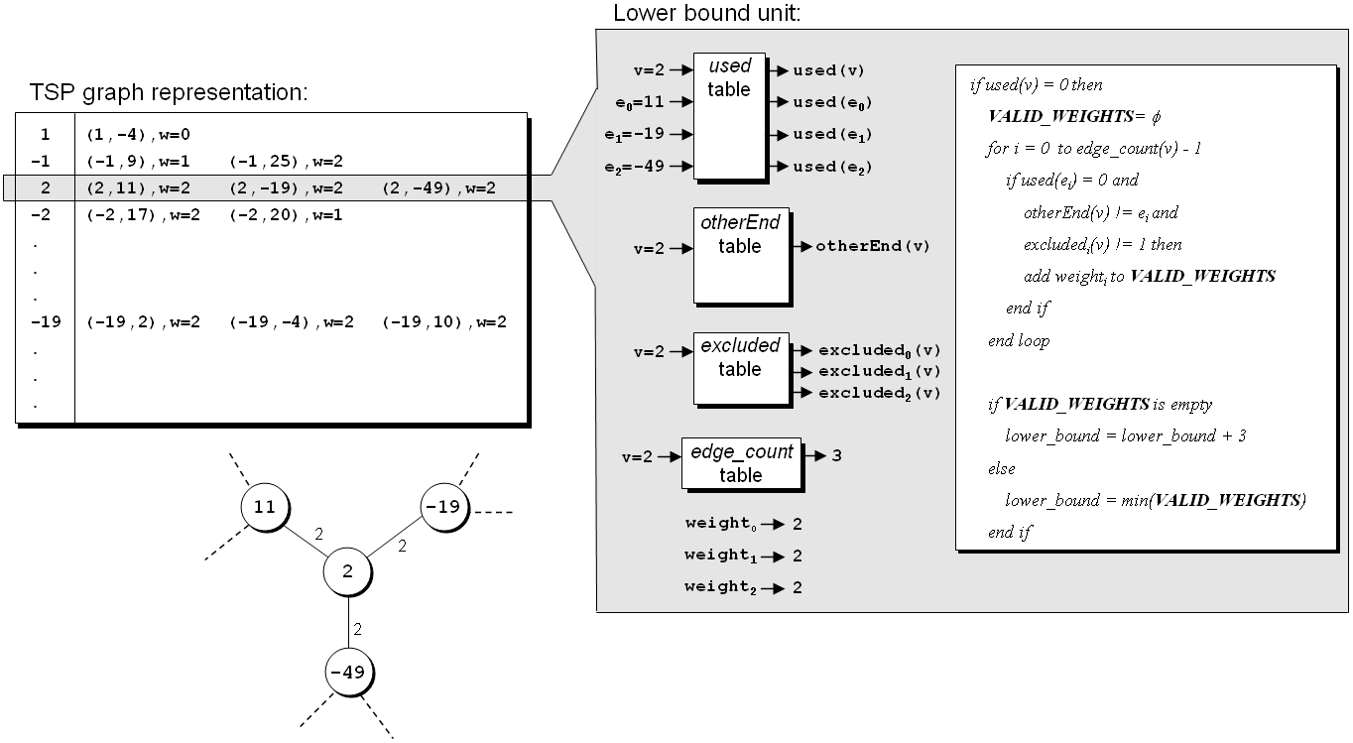
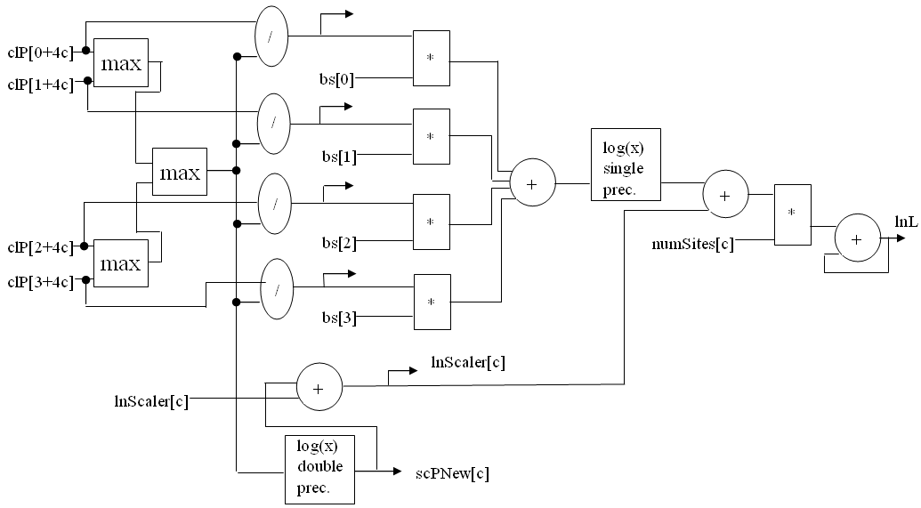
Our Projects
FPGA-based co-processors for computational biology
GRAPPA: MP reconstruction based on gene-rearrangement model
MrBayes: MCMCMC reconstruction based on (sequence data) likelihood model
1000X speedup!
10X speedup!
Tiffany M. Mintz, Jason D. Bakos, "A Cluster-on-a-Chip Architecture for High-Throughput Phylogeny Search," IEEE Trans. on Parallel and Distributed Systems, to appear.
Stephanie Zierke, Jason D. Bakos, "FPGA Acceleration of Bayesian Phylogenetic Inference," BMC Bioinformatics, BMC Bioinformatics 2010, 11:184.
Jason D. Bakos, Panormitis E. Elenis, "A Special-Purpose Architecture for Solving the Breakpoint Median Problem," IEEE Transactions on Very Large Scale Integration (VLSI) Systems, Vol. 16, No. 12, Dec. 2008.
Jason D. Bakos, Panormitis E. Elenis, Jijun Tang, "FPGA Acceleration of Phylogeny Reconstruction for Whole Genome Data," 7th IEEE International Symposium on Bioinformatics & Bioengineering (BIBE'07), Boston, MA, Oct. 14-17, 2007.
Jason D. Bakos, “FPGA Acceleration of Gene Rearrangement Analysis,” 15th Annual IEEE International Symposium on Field-Programmable Custom Computing Machines (FCCM'07), April 23-25, 2007.

Slide 9
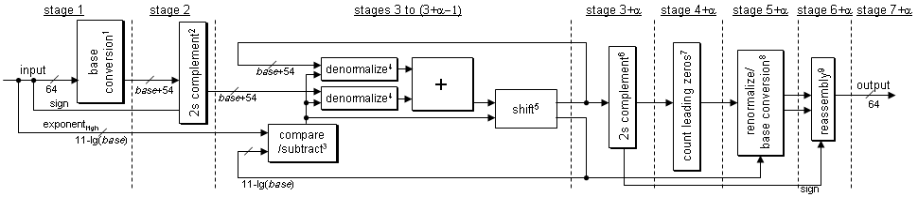
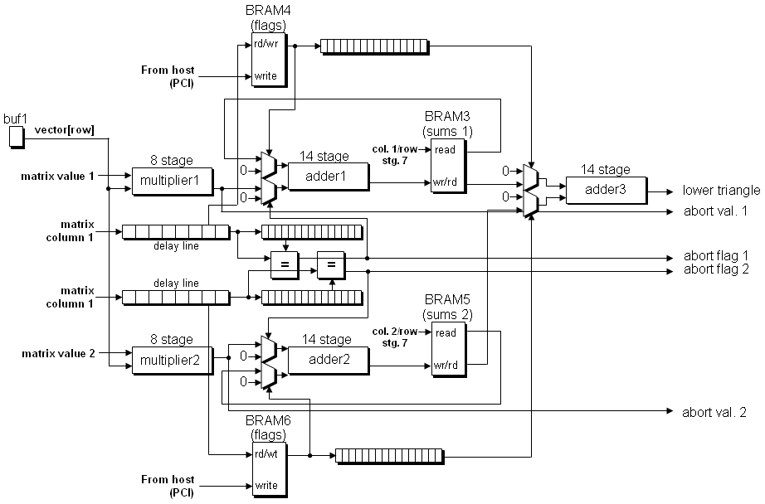
Our Projects
FPGA-based co-processors for sparse linear algebra
Accelerate sparse matrix operations to accelerate sparse numerical linear algebra
Problems: indirect addressing, double precision accumulation, memory bandwidth
Krishna.K. Nagar, Jason D. Bakos, "A High-Performance Double Precision Accumulator," IEEE International Conference on Field-Programmable Technology (IC-FPT'09), Dec. 9-11, 2009.
Yan Zhang, Yasser Shalabi, Rishabh Jain, Krishna K. Nagar, Jason D. Bakos, "FPGA vs. GPU for Sparse Matrix Vector Multiply," IEEE International Conference on Field-Programmable Technology (IC-FPT'09), Dec. 9-11, 2009.
Krishna K. Nagar, Yan Zhang, Jason D. Bakos, "An Integrated Reduction Technique for a Double Precision Accumulator," Proc. Third International Workshop on High-Performance Reconfigurable Computing Technology and Applications (HPRCTA'09), held in conjunction with Supercomputing 2009 (SC'09), Nov. 15, 2009.
Jason D. Bakos, Krishna K. Nagar, "Exploiting Matrix Symmetry to Improve FPGA-Accelerated Conjugate Gradient," 17th Annual IEEE International Symposium on Field Programmable Custom Computing Machines (FCCM'09), April 5-8, 2009.

Slide 10
Double Precision Accumulation
Basic Accumulator Architecture
Feedback Loop
+
Adder Pipeline
Partial sums
Reduction Ckt
Control
Required Design
Mem
Mem

Slide 11
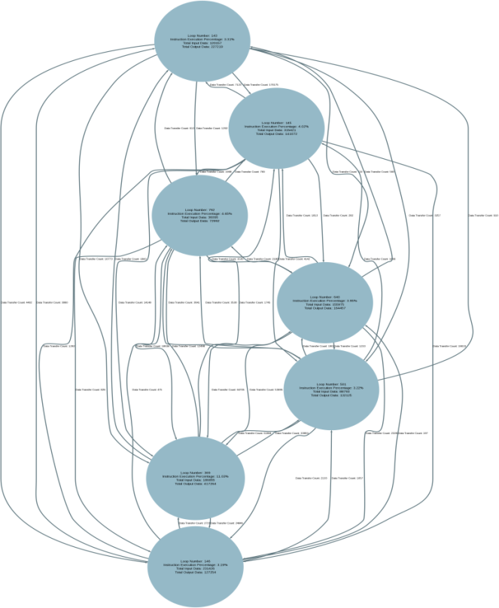
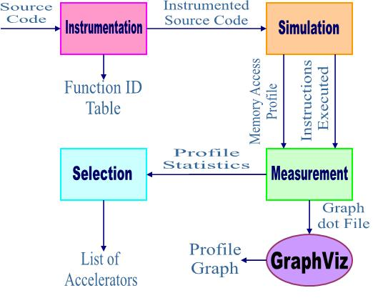
Our Projects: Automated Partitioning
Tiff any M. Mintz, “Systematic Code Partitioning for the Disjoint-Memory Co-Processor Accelerated Execution Model” Ph.D. dissertation, University of South Carolina, 2010.

Slide 12
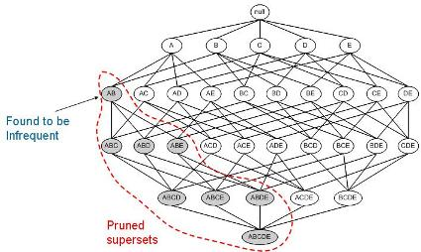
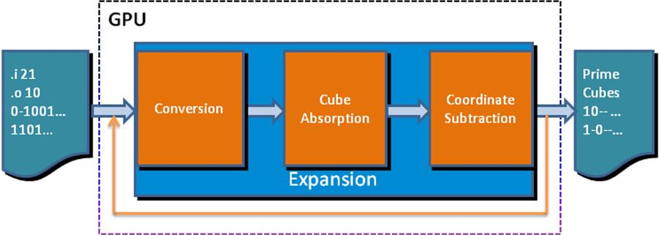
Additional Projects
GPU and FPGA Acceleration of Data Mining
GPU Acceleration of Logic Synthesis
Ibrahim Savran, Jason D. Bakos, "GPU Acceleration of Near-Minimal Logic Minimization," 2010 Symposium on Application Accelerators in High Performance Computing (SAAHPC'10), July 13-15, 2010.

Slide 13
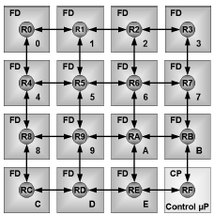
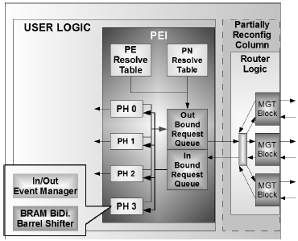
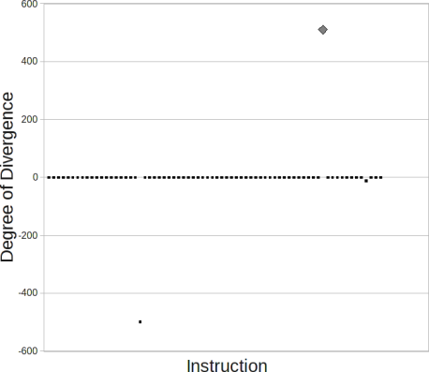
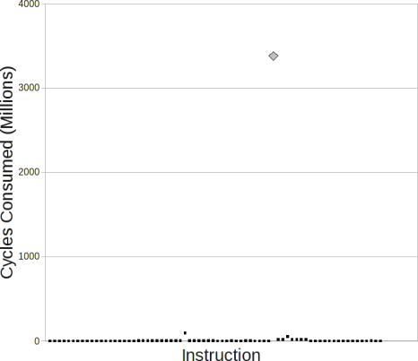
Additional Projects
Multi-FPGA System Architectures
Jason D. Bakos, Charles L. Cathey, E. Allen Michalski, "Predictive Load Balancing for Interconnected FPGAs," 16th International Conference on Field Programmable Logic and Applications (FPL'06), Madrid, Spain, August 28-30, 2006.
Charles L. Cathey, Jason D. Bakos, Duncan A. Buell, "A Reconfigurable Distributed Computing Fabric Exploiting Multilevel Parallelism," 14th Annual IEEE International Symposium on Field-Programmable Custom Computing Machines (FCCM'06), April 24-26, 2006.
GPU Simulation
Patrick A. Moran, Jason D. Bakos, "A PTX Simulator for Performance Tuning CUDA Code," IEEE Trans. on Parallel and Distributed Systems, submitted.

Slide 14
Contact Information
Jason D. Bakos
Office: 3A52
E-mail: jbakos@sc.edu
http://www.cse.sc.edu/~jbakos
Heterogeneous and Reconfigurable Computing (HeRC) Lab:
Lab: 3D15
http://herc.cse.sc.edu

Slide 15
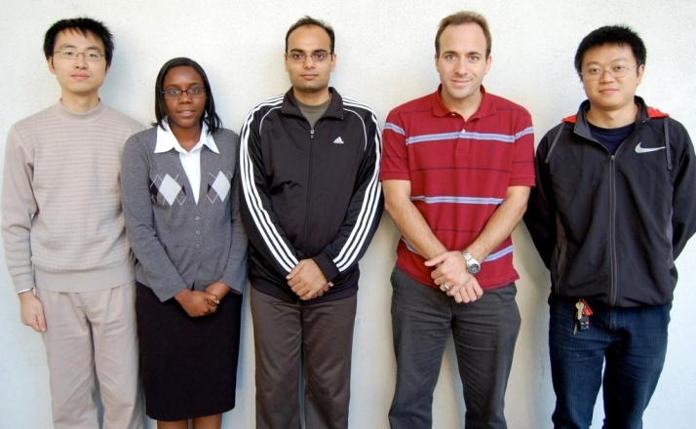
Our Group
Tiffany Mintz
Krishna Nagar
Jason Bakos
Yan Zhang
Zheming Jin
Heterogeneous and Reconfigurable Computing Group
http://herc.cse.sc.edu

